Slide 1
Chapter 12
Fluids in Motion; Flow Rate and the Equation of Continuity
Bernoulli’s Equation
Applications of Bernoulli’s Principle
Viscosity
Flow in Tubes: Poiseuille’s Equation, Blood Flow

Slide 2
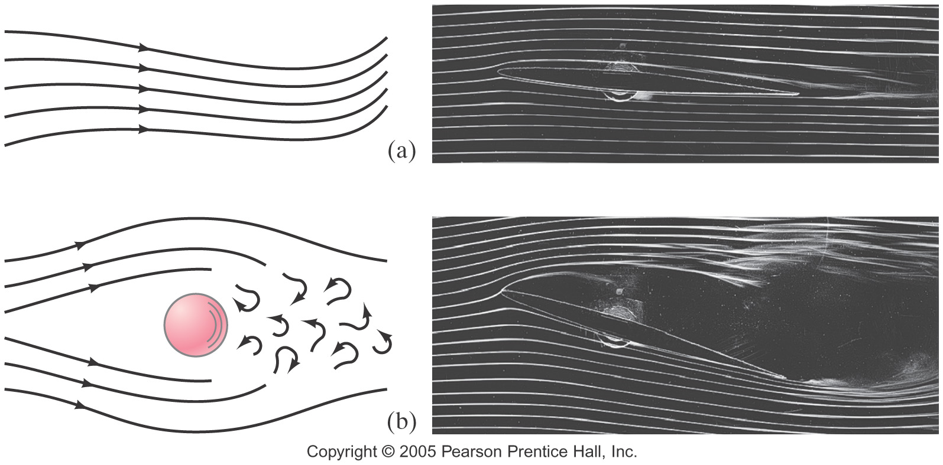
If the flow of a fluid is smooth, it is called streamline or laminar flow (a).
Above a certain speed, the flow becomes turbulent (b). Turbulent flow has eddies; the viscosity of the fluid is much greater when eddies are present.

Slide 3

We will deal with laminar flow.
The mass flow rate is the mass that passes a given point per unit time. The flow rates at any two points must be equal, as long as no fluid is being added or taken away.
This gives us the equation of continuity:

Slide 4

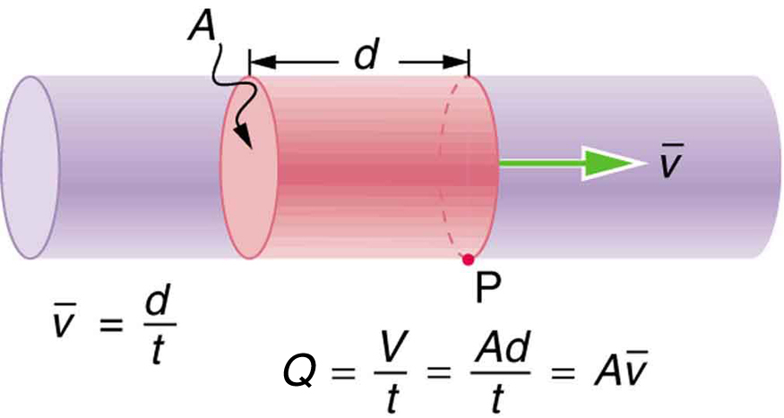
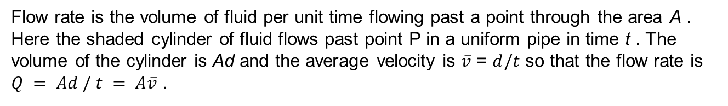
Figure 12.2
Flow rate is the volume of fluid per unit time flowing past a point through the area A . Here the shaded cylinder of fluid flows past point P in a uniform pipe in time t . The volume of the cylinder is Ad and the average velocity is $\overline{v}$ = $d/t$ so that the flow rate is $Q = Ad / t = A\overline{v}$ .

Slide 5

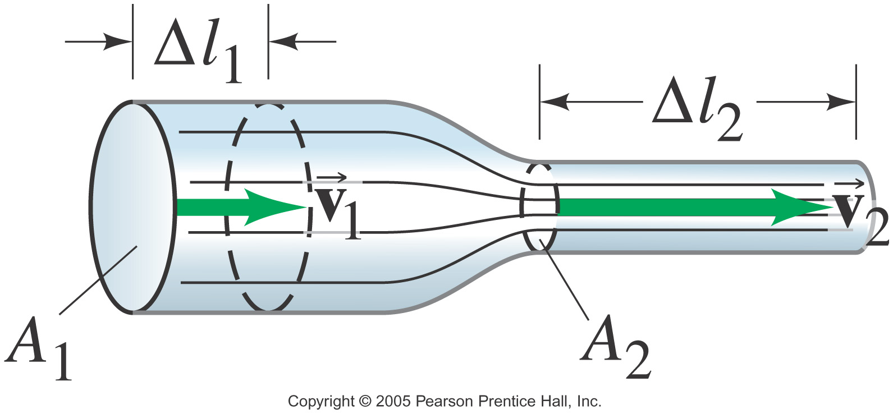
Flow Rate and the Equation of Continuity
If the density doesn’t change – typical for liquids – this simplifies to . Where the pipe is wider, the flow is slower.

Slide 6
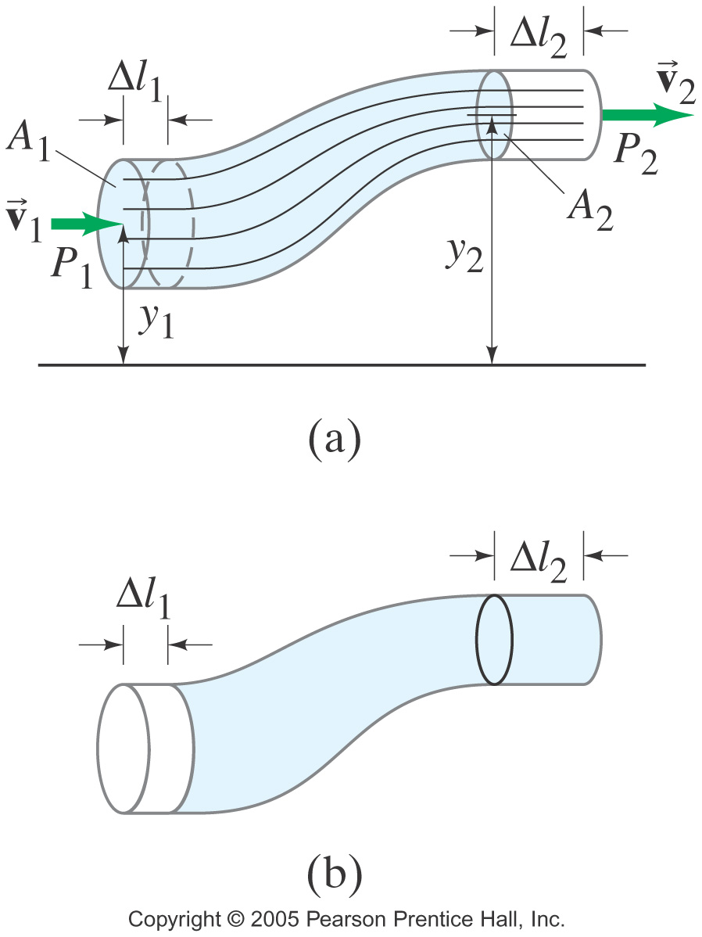

Bernoulli’s Equation
A fluid can also change its height. By looking at the work done as it moves, we find:
This is Bernoulli’s equation. One thing it tells us is that as the speed goes up, the pressure goes down.

Slide 7
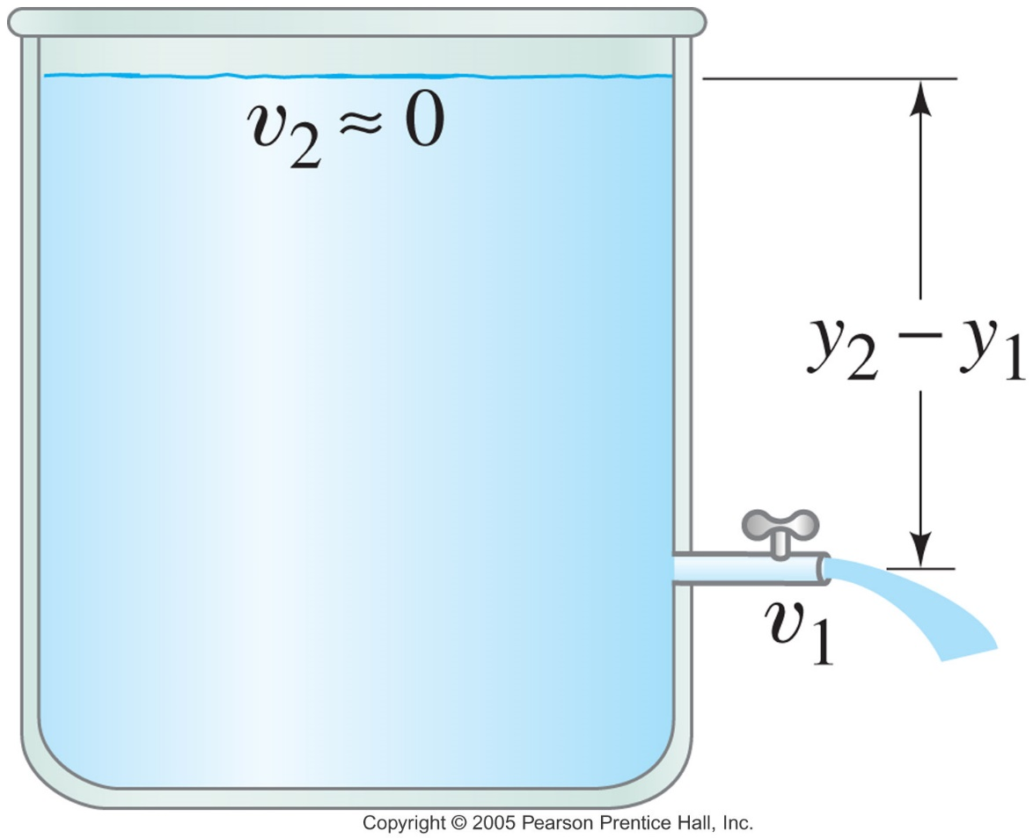

Using Bernoulli’s principle, we find that the speed of fluid coming from a spigot on an open tank is:
This is called Torricelli’s theorem.

Slide 8
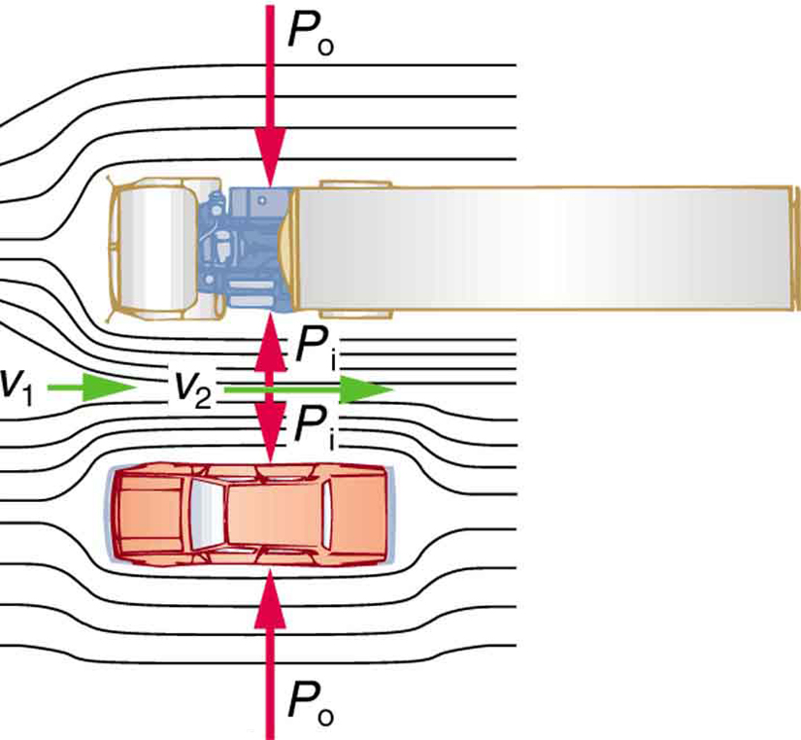
Figure 12.4
An overhead view of a car passing a truck on a highway. Air passing between the vehicles flows in a narrower channel and must increase its speed ( v₂ is greater than v₁), causing the pressure between them to drop ( P_{i} is less than P_{o} ). Greater pressure on the outside pushes the car and truck together.

Slide 9
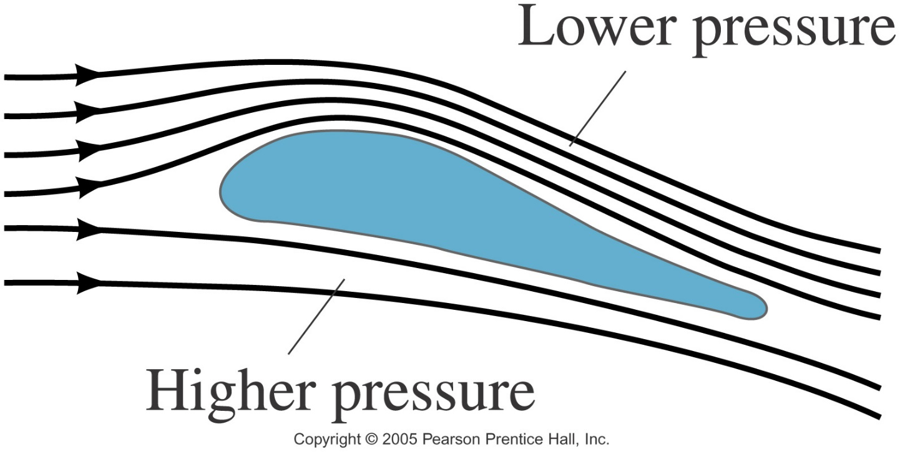
Lift on an airplane wing is due to the different air speeds and pressures on the two surfaces of the wing.

Slide 10
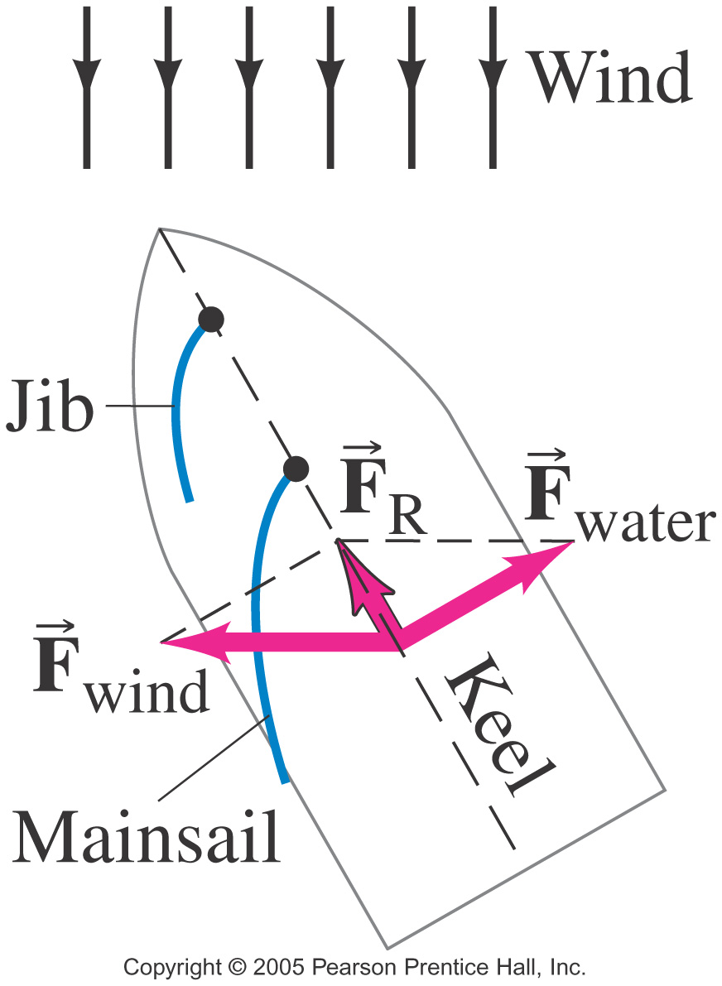
A sailboat can move against the wind, using the pressure differences on each side of the sail, and using the keel to keep from going sideways.

Slide 11
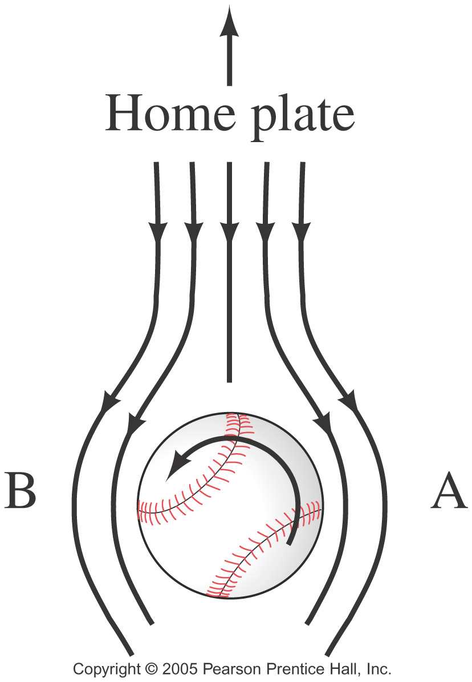
A ball’s path will curve due to its spin, which results in the air speeds on the two sides of the ball not being equal.

Slide 12
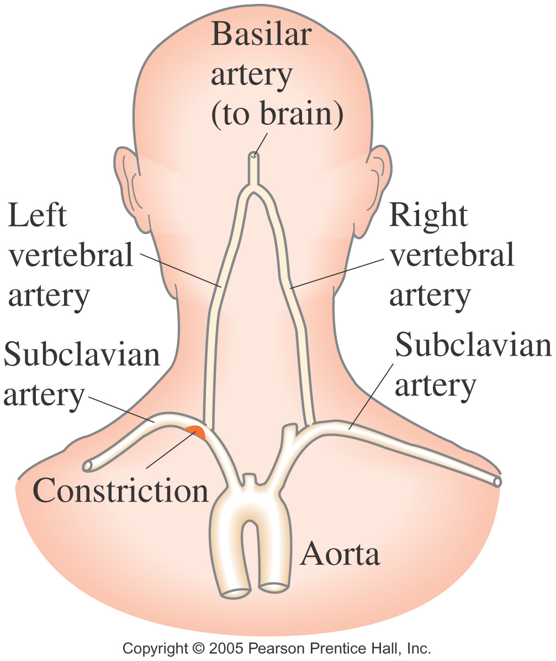
A person with constricted arteries will find that they may experience a temporary lack of blood to the brain (TIA) as blood speeds up to get past the constriction, thereby reducing the pressure.

Slide 13
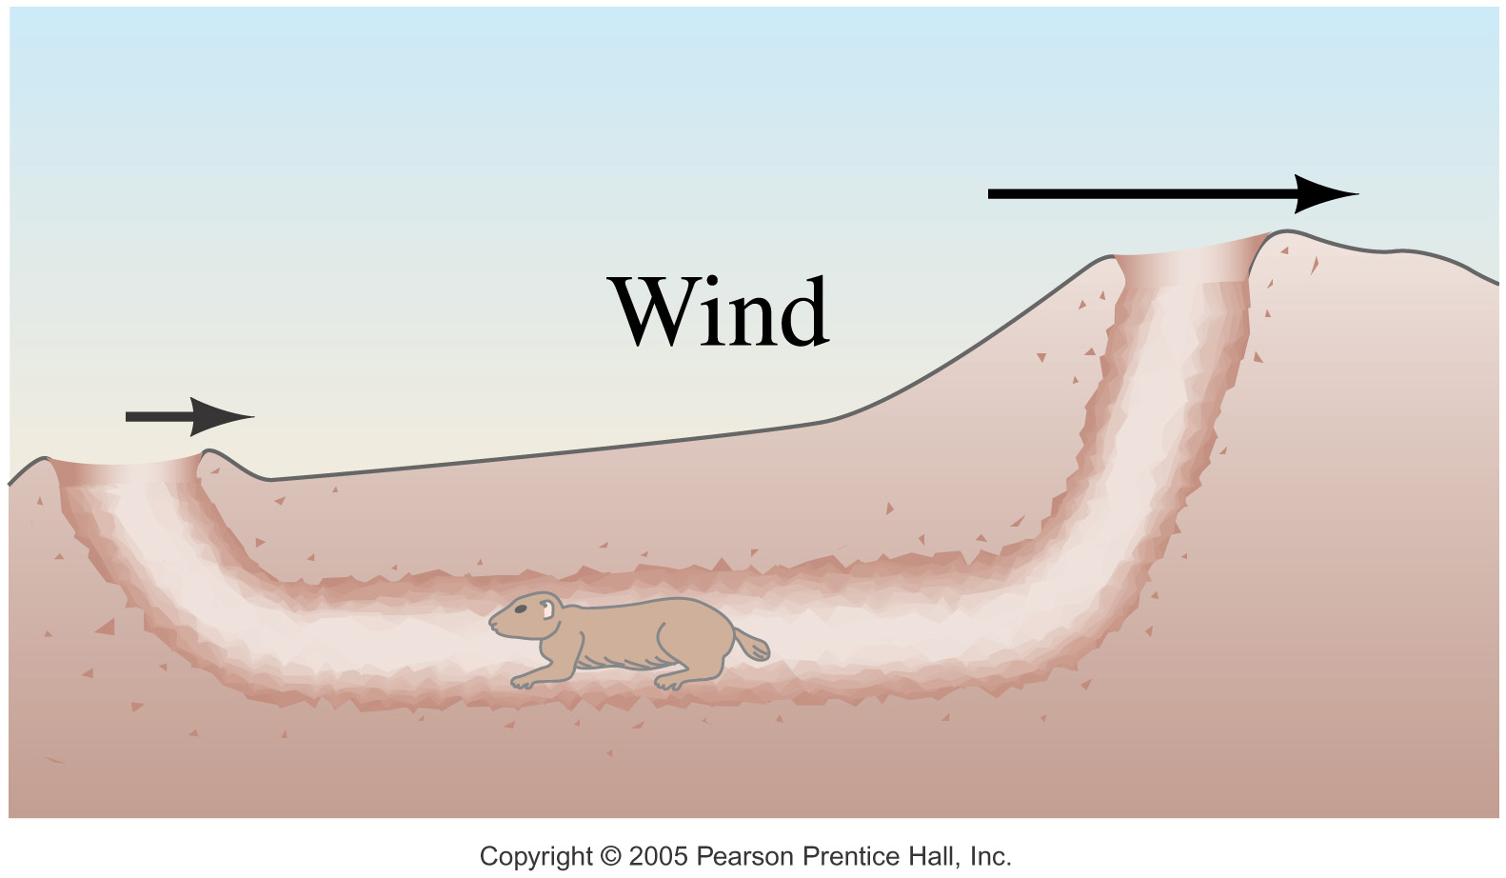
Air flow across the top helps smoke go up a chimney, and air flow over multiple openings can provide the needed circulation in underground burrows.

Slide 14
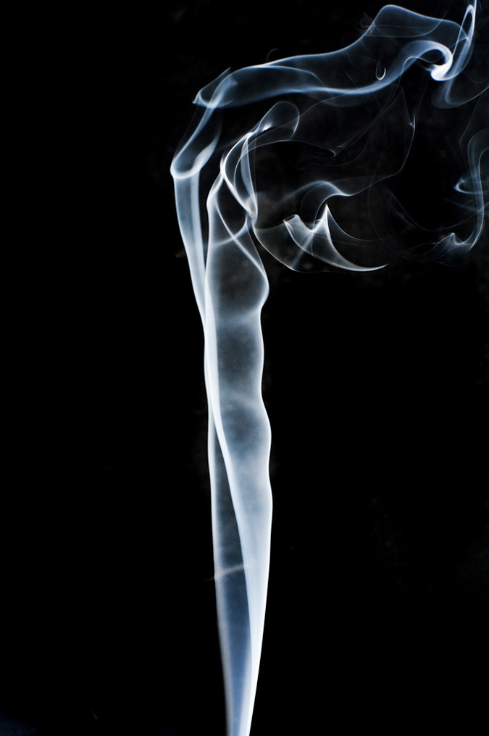
Figure 12.10
Smoke rises smoothly for a while and then begins to form swirls and eddies. The smooth flow is called laminar flow, whereas the swirls and eddies typify turbulent flow. If you watch the smoke (being careful not to breathe on it), you will notice that it rises more rapidly when flowing smoothly than after it becomes turbulent, implying that turbulence poses more resistance to flow.

Slide 15
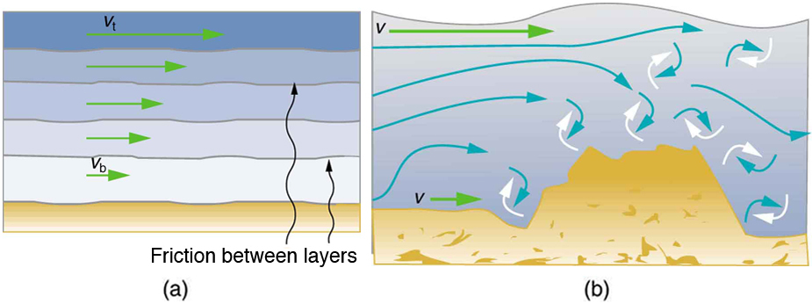
Figure 12.11
Laminar flow occurs in layers without mixing. Notice that viscosity causes drag between layers as well as with the fixed surface.
An obstruction in the vessel produces turbulence. Turbulent flow mixes the fluid. There is more interaction, greater heating, and more resistance than in laminar flow.

Slide 16
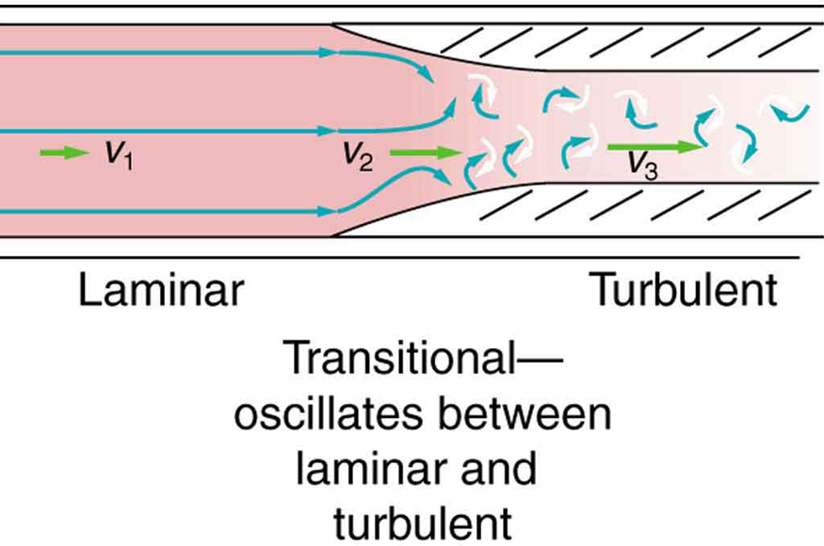
Figure 12.17
Flow is laminar in the large part of this blood vessel and turbulent in the part narrowed by plaque, where velocity is high. In the transition region, the flow can oscillate chaotically between laminar and turbulent flow.

Slide 17
The graphic shows laminar flow of fluid between two plates of area A . The bottom plate is fixed. When the top plate is pushed to the right, it drags the fluid along with it.

Slide 18

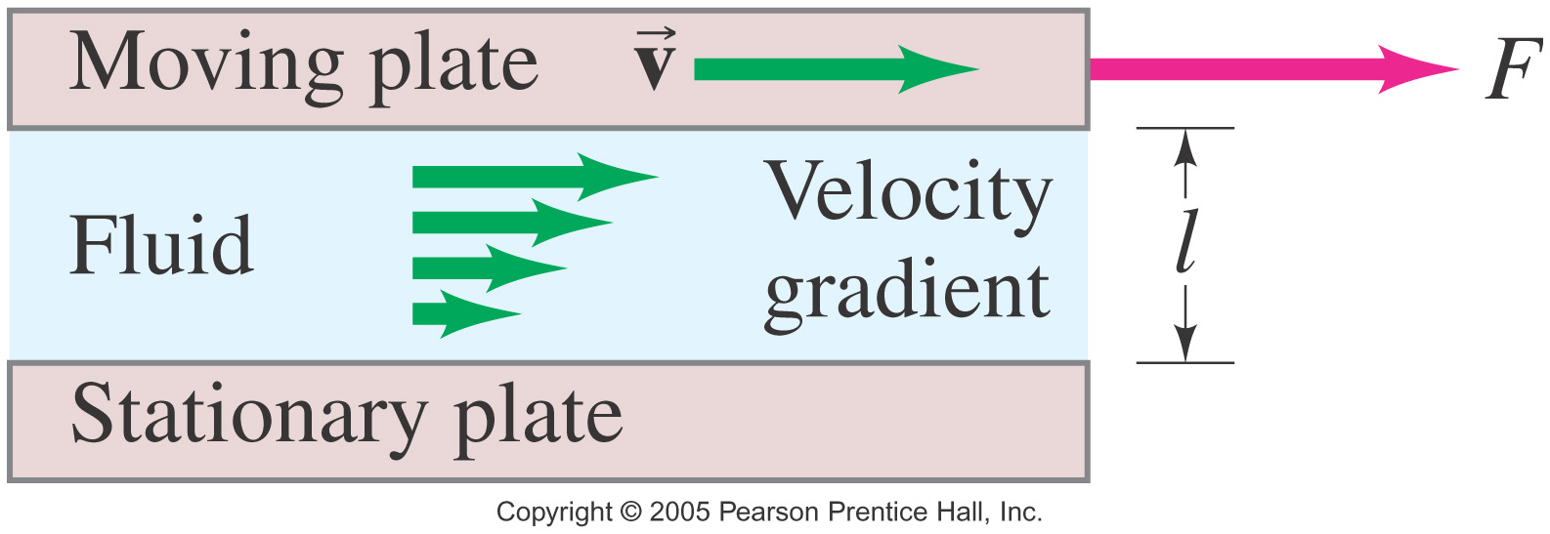
Viscosity
Real fluids have some internal friction, called viscosity.
The viscosity can be measured; it is found from the relation
where η is the coefficient of viscosity.

Slide 19
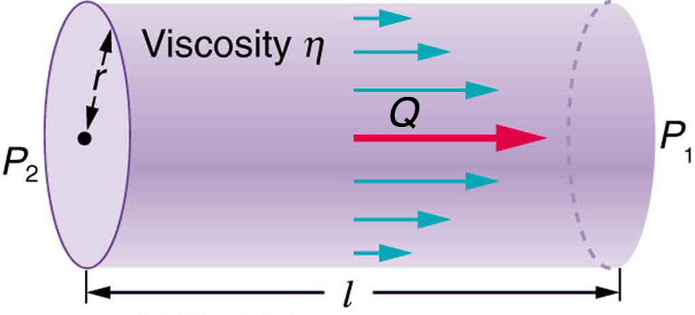
Figure 12.14
Poiseuille’s law applies to laminar flow of an incompressible fluid of viscosity η through a tube of length l and radius r . The direction of flow is from greater to lower pressure. Flow rate Q is directly proportional to the pressure difference P₂ − P₁ , and inversely proportional to the length l of the tube and viscosity η of the fluid. Flow rate increases with r⁴ , the fourth power of the radius.

Slide 20
If fluid flow in a tube has negligible resistance, the speed is the same all across the tube.
When a viscous fluid flows through a tube, its speed at the walls is zero, increasing steadily to its maximum at the center of the tube.
(c) The shape of the Bunsen burner flame is due to the velocity profile across the tube.

Slide 21
Laminar Flow Confined to Tubes—Poiseuille’s Law
What causes flow? The answer is pressure difference.
Flow rate Q is in the direction from high to low pressure. The greater the pressure differential between two points, the greater the flow rate. This relationship can be stated as
Q = (P₂ − P₁)/R
where P₁ and P₂ are the pressures at two points, such as at either end of a tube, and R is the resistance to flow. The resistance R includes everything, except pressure, that affects flow rate. For example, R is greater for a long tube than for a short one. The greater the viscosity of a fluid, the greater the value of R . Turbulence greatly increases R , whereas increasing the diameter of a tube decreases R .

Slide 22
The resistance R to laminar flow of an incompressible fluid having viscosity η through a horizontal tube of uniform radius r and length l is given by
R =8ηl/πr⁴
This equation is called Poiseuille’s law for resistance.
Q = (P₂ − P₁)πr⁴/8ηl

Slide 23
The volume flow rate is proportional to the pressure difference, inversely proportional to the length of the tube and to the viscosity, and proportional to the fourth power of the radius of the tube.
Plaque Deposits Reduce Blood Flow
Suppose the flow rate of blood in a coronary artery has been reduced to half its normal value by plaque deposits. By what factor has the radius of the artery been reduced, assuming no turbulence occurs?

Slide 24
With a constant pressure difference assumed and the same length and viscosity, along the artery we have
Q₁/r₁⁴ = Q₂/r₂⁴
So, given that Q₂ = 0.5 Q₁ , we find that r₂ ⁴ = 0.5 r₁ ⁴.
Therefore, r₂ = (0.5)^{0.25}r₁ = 0.841r₁, a decrease in the artery radius of 16%.

Slide 25
What Pressure Produces This Flow Rate?
An intravenous (IV) system is supplying saline solution to a patient at the rate of 0.120 cm³/s through a needle of radius 0.150 mm and length 2.50 cm. What pressure is needed at the entrance of the needle to cause this flow, assuming the viscosity of the saline solution to be the same as that of water? The gauge pressure of the blood in the patient’s vein is 8.00 mm Hg. (Assume that the temperature is 20ºC).

Slide 26
P₂ = (8ηl/πr⁴)Q + P₁
P₁ is given as 8.00 mm Hg, which converts to 1.066×10³ N/m². Substituting this and the other known values yields
P₂ = [8(1.00×10⁻³ N ⋅ s/m²)(2.50×10⁻² m)/π(0.150×10⁻³ m)⁴](1.20×10⁻⁷ m³/s) + 1.066×10³ N/m² = 1.62×10⁴ N/m²

Slide 27
An indicator called the Reynolds number N_{R} can reveal whether flow is laminar or turbulent. For flow in a tube of uniform diameter, the Reynolds number is defined as
N_{R} = 2ρvr/η (flow in tube)
where ρ is the fluid density, v its speed, η its viscosity, and r the tube radius. The Reynolds number is a unitless quantity.
Experiments have revealed that N_{R} is related to the onset of turbulence. For N_{R} below about 2000, flow is laminar. For N_{R} above about 3000, flow is turbulent. For values of N_{R} between about 2000 and 3000, flow is unstable—that is, it can be laminar, but small obstructions and surface roughness can make it turbulent, and it may oscillate randomly between being laminar and turbulent. The blood flow through most of the body is a quiet, laminar flow. The exception is in the aorta, where the speed of the blood flow rises above a critical value of 35 m/s and becomes turbulent.

Slide 28
Is This Flow Laminar or Turbulent?
Calculate the Reynolds number for flow in the needle considered in previous Example to verify the assumption that the flow is laminar. Assume that the density of the saline solution is 1025 kg/m³ .
We have all of the information needed, except the fluid speed v, which can be calculated from v = Q / A = 1.70 m/s.
Entering the known values into N_{R} = 2ρvr/η =
2(1025 kg/m³)(1.70m/s)(0.150×10⁻³ m)/1.00×10⁻³ N ⋅ s/m² = 523.
Since N_{R} is well below 2000, the flow should indeed be laminar.

Slide 29
Summary
Fluid flow can be laminar or turbulent.
The product of the cross-sectional area and the speed is constant for horizontal flow.
Where the velocity of a fluid is high, the pressure is low, and vice versa.
Viscosity is an internal frictional force within fluids.

